Slide 1
Investigating Motor Skill Training and User Arousal Levels in VR : Pilot Study and Observations
IEEE VR 2021

Slide 2
Introduction
1. Gait analysis is a well-established tool in the clinical environment to quantify and objectively describe patient walking movement.
2. VR has become increasingly popular in terms of gait analysis and treatment in
research, as it allows to display immersive controllable environments.
3. However, training methods in VR are often transferred from the real world without considering effects of immersion on the user.

Slide 3
Introduction
4. In this paper, we assess differences between gait variability in VR compared to an in vivo situation in relation to different walking tasks.
(1) Avatar appearance.
(2) Virtual camera perspective.
(3) Environmental cues.

Slide 4
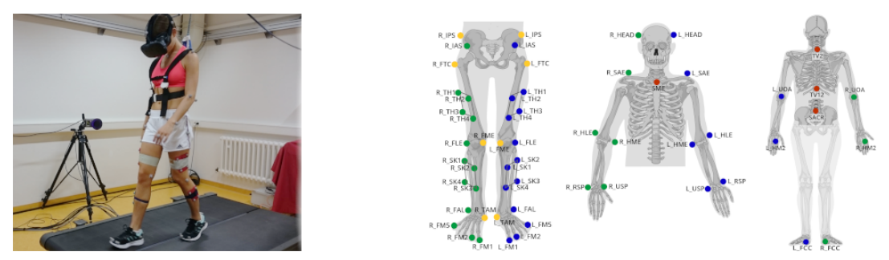
Method
1. 18 Participants (7 female, 11 male).
2. Apparatus: Treadmill, marker-based optical motion capture system, and HMD.

Slide 5
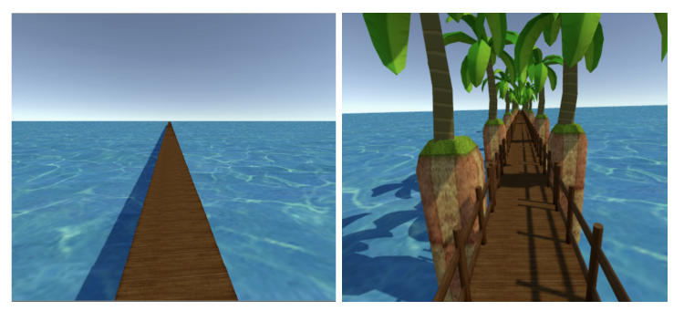
Method
3. Virtual environment: Unity3D, jetty (防波堤) surrounded by water.

Slide 6
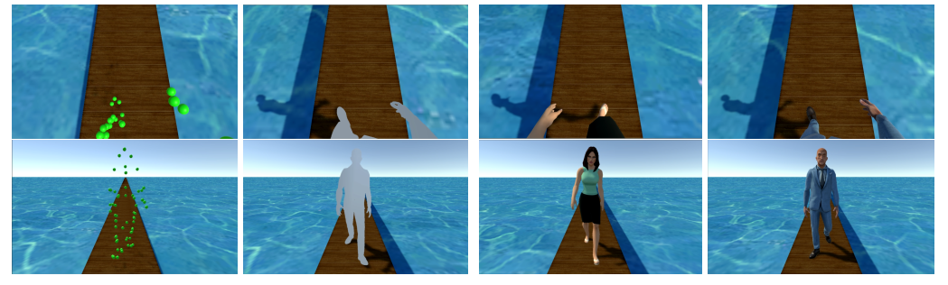
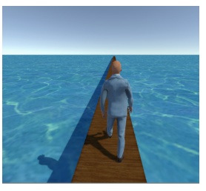
Method
4. Condition
(1) In Vivo Baseline (in vivo)-真实场景.
(2) No Avatar (NoVis)-无人物模型.
(3) Pointcloud (PTC)-点云人物模型.
(4) Silhouette (SIL)-人物轮廓模型.
(5) Humanoid (HUM)-正常人物模型.
(6) Exocentric (EXO)-正常人物模型+越肩视角.
(7) Environment (HUM + ENV)-正常人物模型+越肩视角+棕榈、栏杆.

Slide 7
Method
5. View directions
(1) Down.
(2) Straight.
(3) Looking around in the environment.
6. Measures
(1) Gait parameters: stride length, step width, stride time, coefficient of variation.
(2) AttrakDiff questionnaire.
(3) Witmer and Singer presence questionnaire.

Slide 8
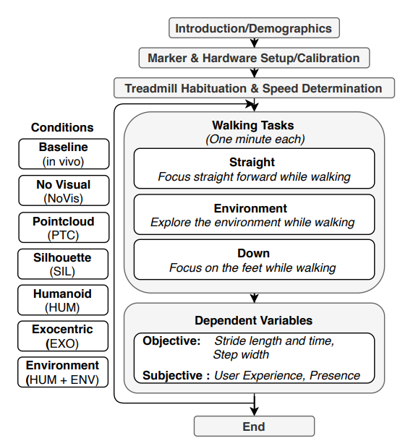

Slide 9
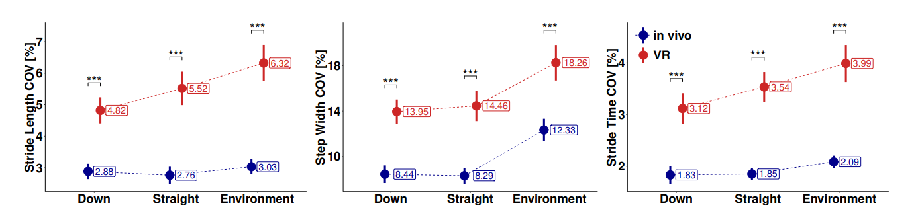
Results
1. VR and Vivo.

Slide 10
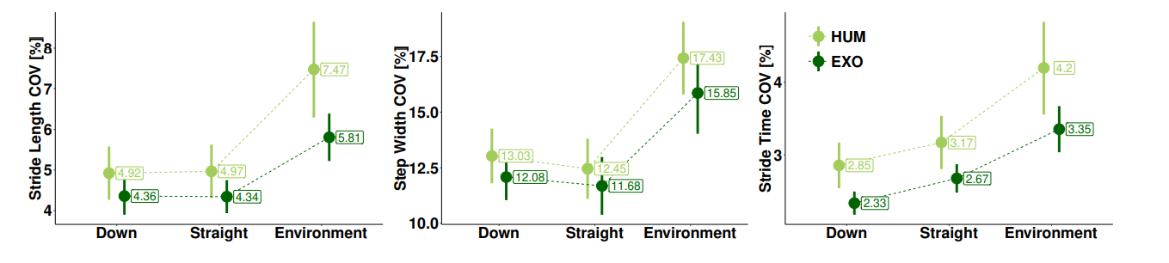
Results
2. Perspective: The analysis of variance for the COV resulted in main significant effects for task (down, straight, environment) for all gait parameters.

Slide 11
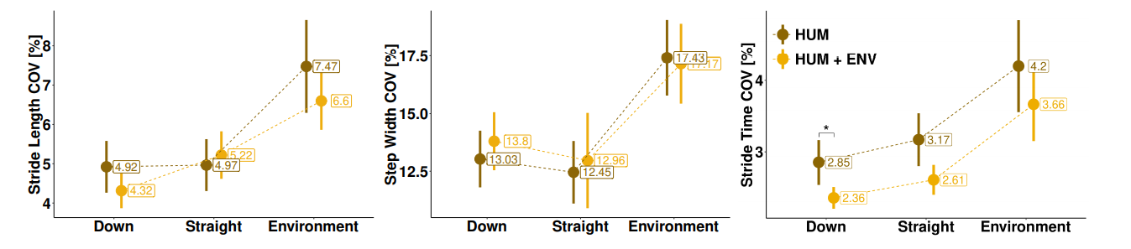
Results
3. Context: Results of the COV analysis revealed a significant main effect for condition (HUM, HUM + ENV) for stride time of down task.

Slide 12
Results
4. Avatar appearance: The conducted analysis of variance showed a main effect for task in terms of stride time, length as well as step width.
5. User Experience:
(1) There was significant differences between the two perspectives (HUM, EXO).
(2) For all subcategories HUM was rated highest and NoVis lowest.

Slide 13
Conclusion
1. Results show that natural gait of participants was significantly different to the respective gait characteristics in VR.
2. Our results further suggest that particular care has to be taken when comparing gait data or results from subjects immersed in VR and that equivalence of characteristics with in vivo may not be blindly assumed.

